Slide 1

University Search System
Umar Khalid 22979
Ashnah Khalid Khan 22889
Muhammad Ali Haider 23047

Slide 2

Importance of University Search System
Lists universities in order
Searches for a particular institute and its discipline
Let's user search by applying multiple filters to make search more efficient
Lists down the universities and its rankings
File can be updated, at any time.

Slide 3

DATA STRUCTURES USED
Dynamic Arrays
Singly Linked Lists
Hash Table
Binary Search Tree

Slide 4
Dynamic Array
Traversing in an Array is faster than Linked List.
Array is also used for direct memory access.

Slide 5

Linked Lists
Easy to store large amount of data in a linked list.
No predefined amount of the data set is required, unlike in arrays
Each node contains data of University, City, Country, and discipline.

Slide 6
Hashing
Collisions Resolution
Direct access to data

Slide 7
Binary Search Tree
Get data in any order
LNR for Ranking of Universities

Slide 8

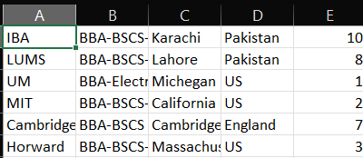
DATA USED IN OUR PROJECT

Slide 9
University Node
NAME | RANK | COUNTRY | CITY | DISCIPLINE | NEXT
STRING
STRING
University Node
STRING
Int
STRING []
Array of Discipline

Slide 10
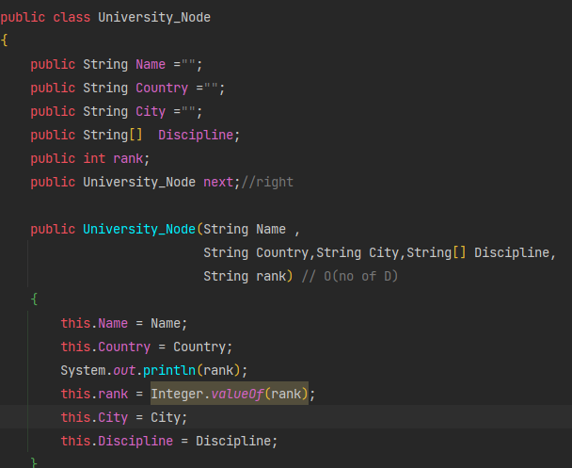

Slide 11
BST Node & BST
ROOT
Uni
University Node
Left
BST Node
Right
BST Node
BST Node
BST Node
In order to display the data, binary search tree is used. Only references are inserted, so no extra space is required. The use of BST is most efficient also because data needs to be displayed in-order after searching which is easily accomplished using its LNR function.
BST Node
BST Node
BST Node

Slide 12
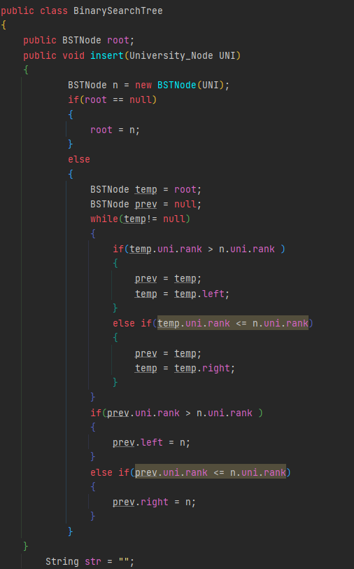
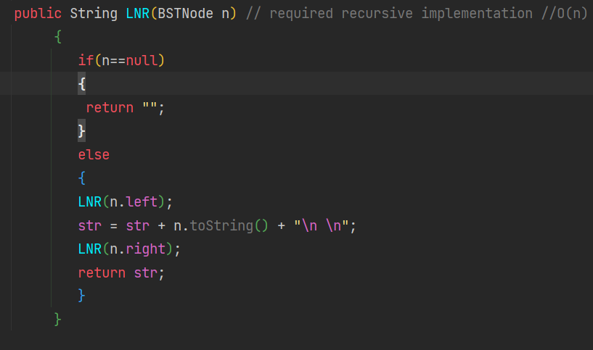

Slide 13
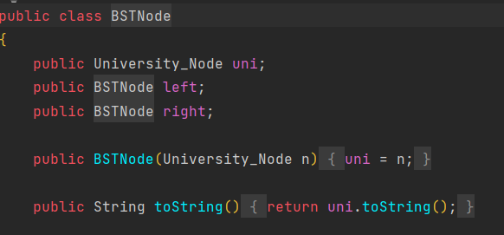

Slide 14
University Linked List
Head
Tail
University Node
University Node
University Node
A linked list is used to store the data for all universities as the file is read. Each time, a node is created which includes the respective info for each university and is inserted at the tail of the linked list. Since the data set is very large and very variable, using linked list allows us to allocate memory for data as and when needed rather than all at once.

Slide 15
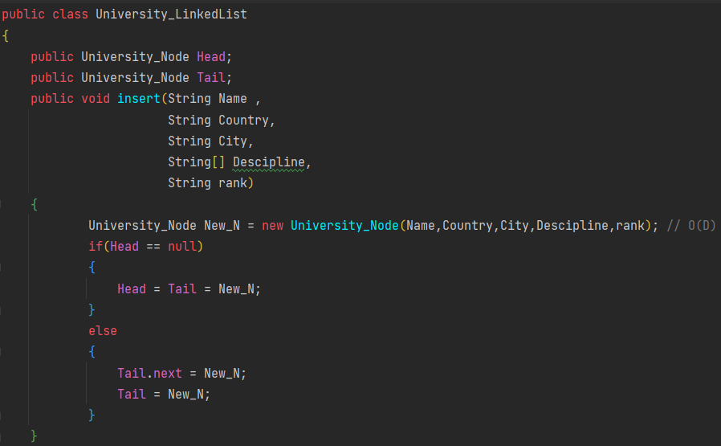

Slide 16
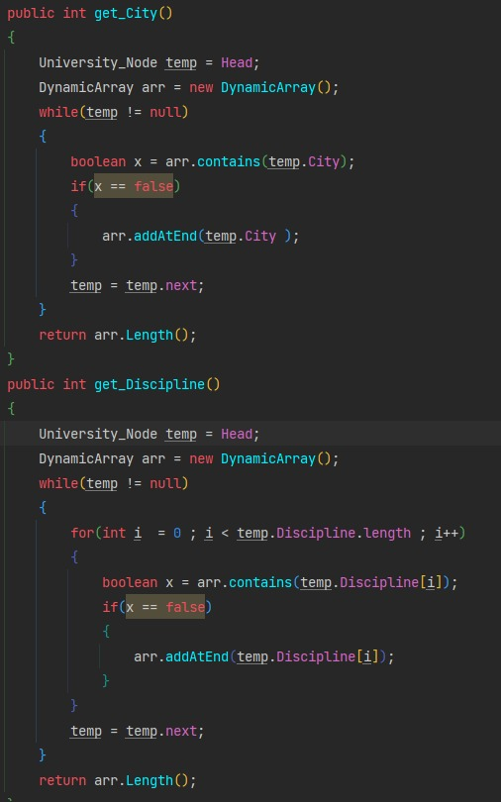
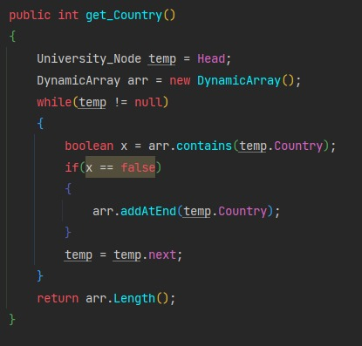
Count Of Country, City and Disciplines in the Data

Slide 17
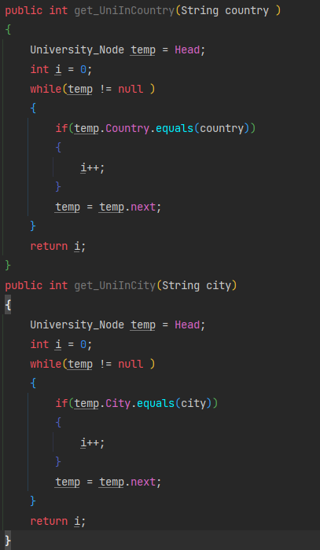
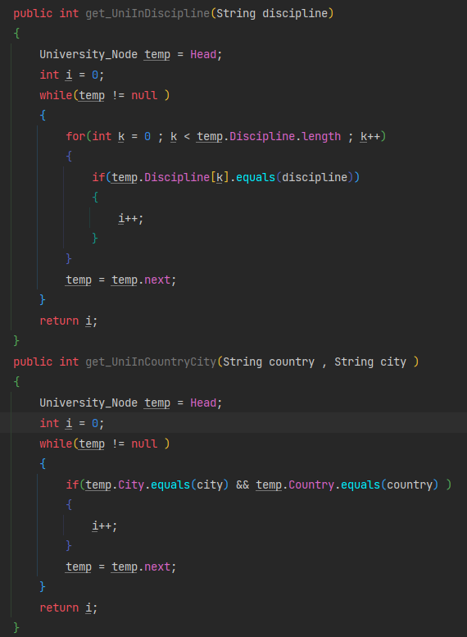
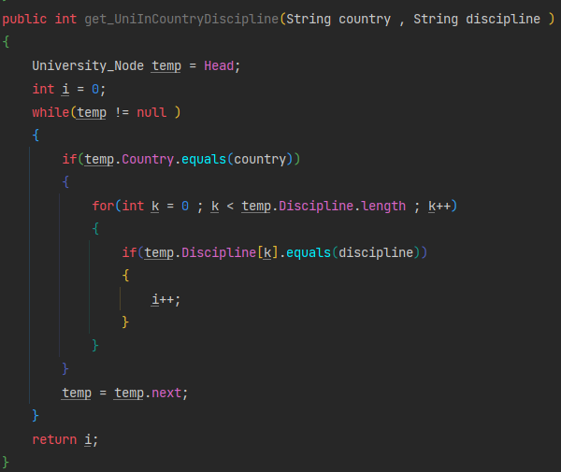
Count Of Universities w.r.t the possible filters

Slide 18
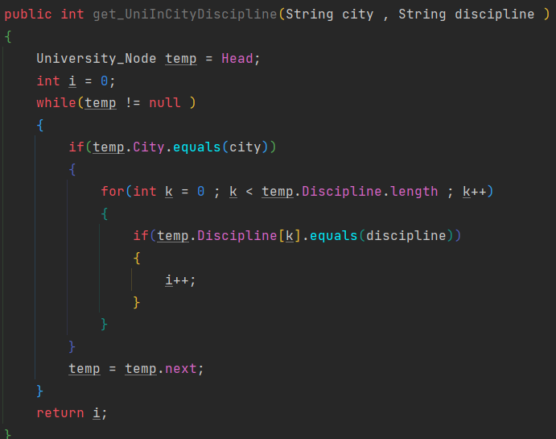
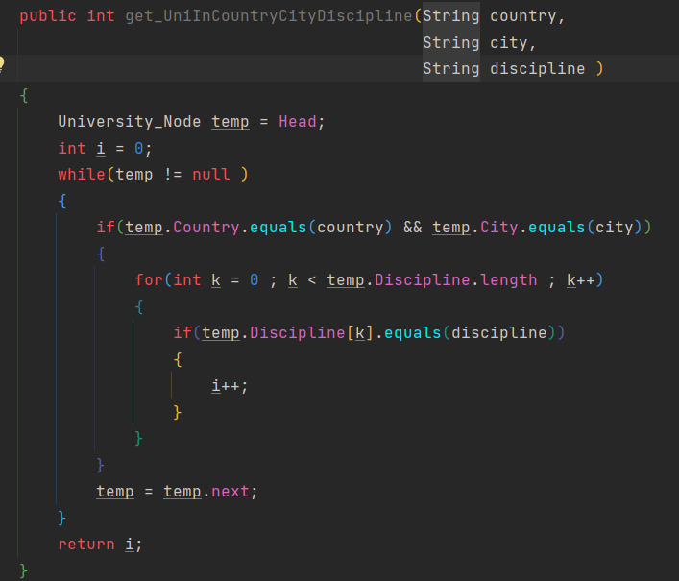

Slide 19
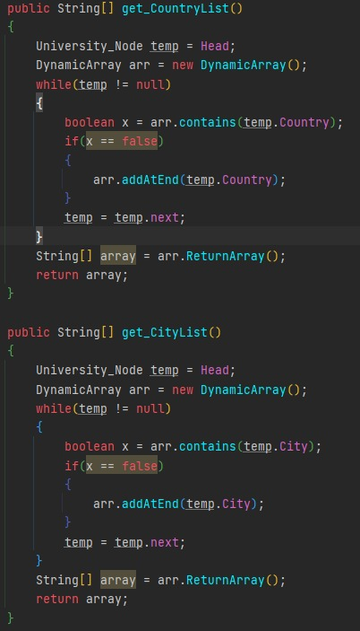
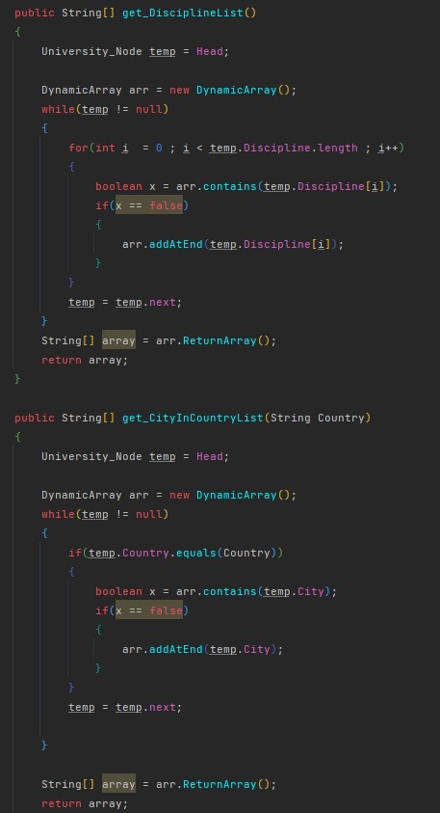
List of Country, City, Discipline and their combinations , in the data

Slide 20
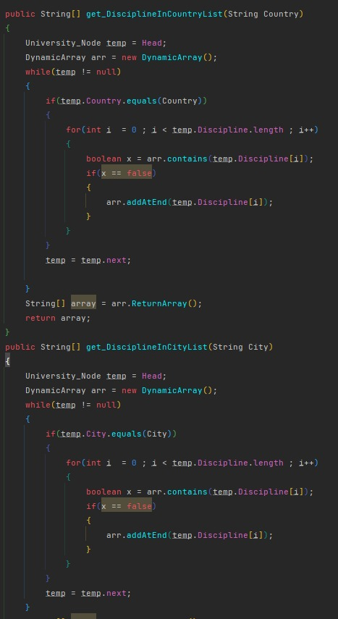
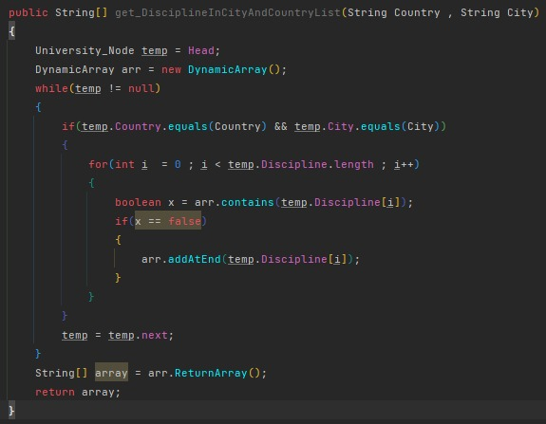

Slide 21
Node
Name (String) | Sec Layer Node [ ] | Third Layer Node [ ] | Uni List UniversityNode [ ] | Uni Tree BinarySearchTree
Node
Node
Node
Node
Node
Node
Node
Node
University Node
University Node
University Node
University Node
BST Node
BST Node
BST Node

Slide 22
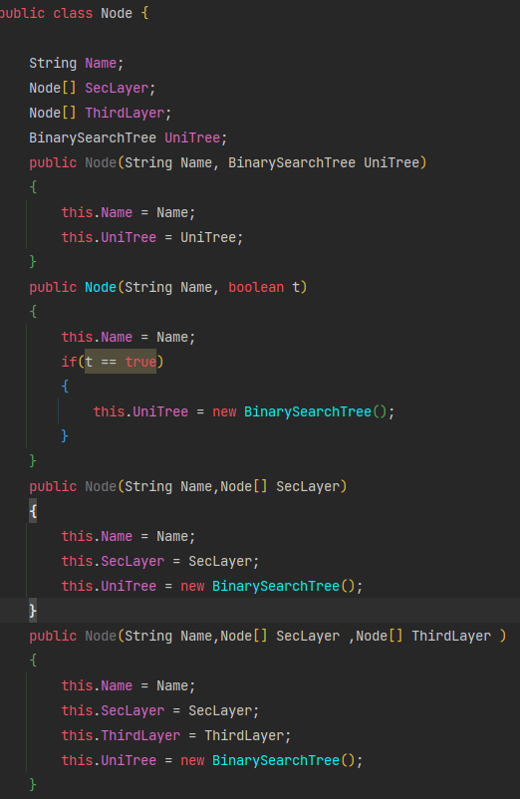

Slide 23
Dynamic Array
Arr[ ]
(String [ ])
currIndex
(Int)
Capacity
(Int)
String
String
String

Slide 24
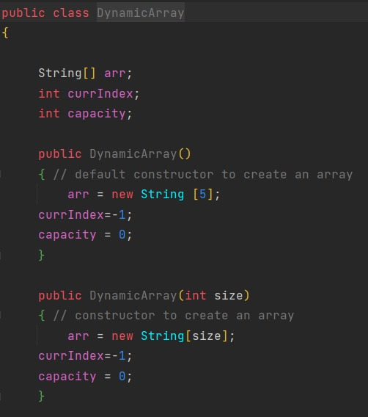
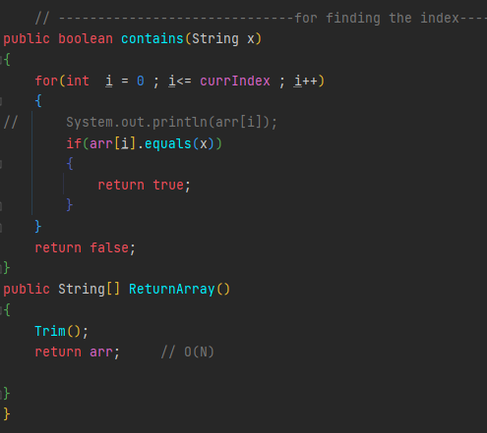
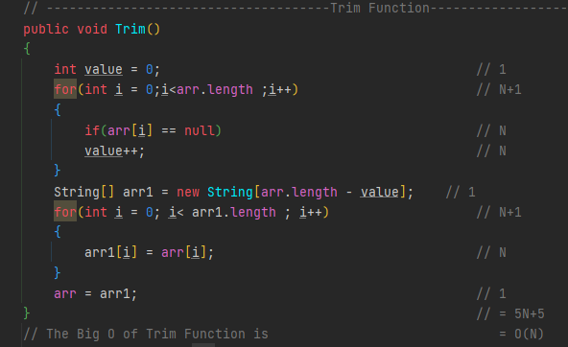

Slide 25
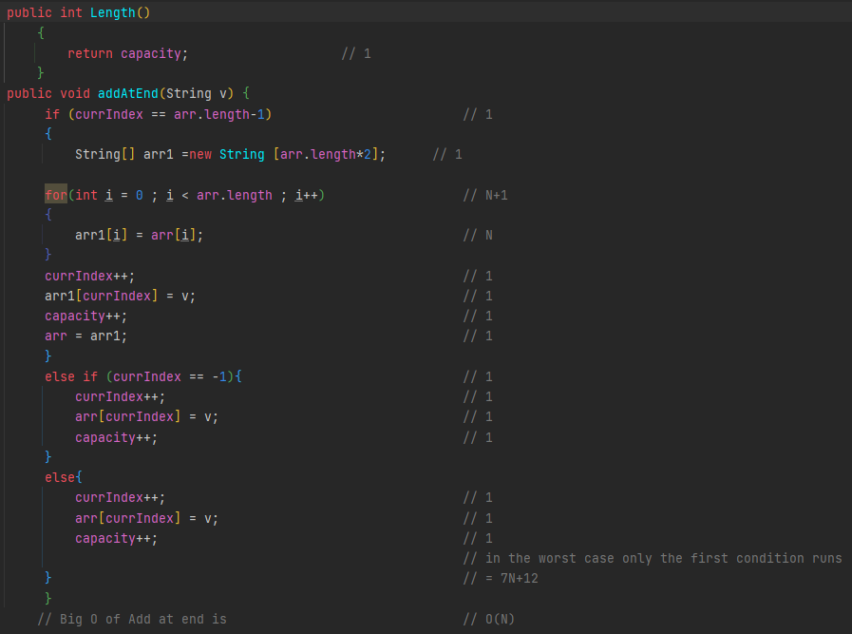

Slide 26
HashTable
Country Node [ ] | City Node [ ] | Discipline Node [ ] | List
To sort the data in order to accomplish O(1) searching capability, hash tables are used since they allow direct access using index numbers. In order to accommodate 3 different possibilities of searching criteria, 3 such arrays are created within the hash table. All arrays are arrays of nodes which include the instance of a String Name, another node array and a binary search tree. For each node with the required String values, the relevant university are inserted in its binary search tree.
University Linked List

Slide 27
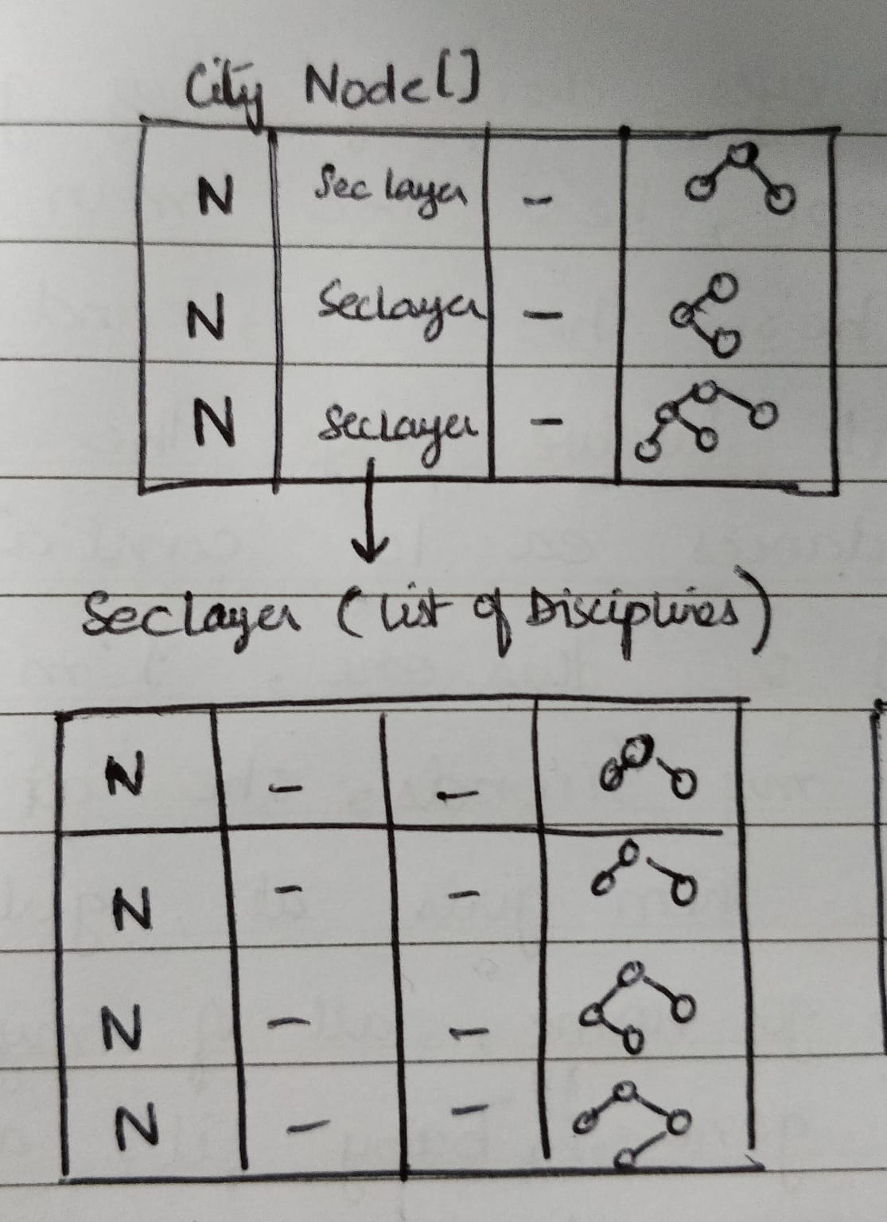
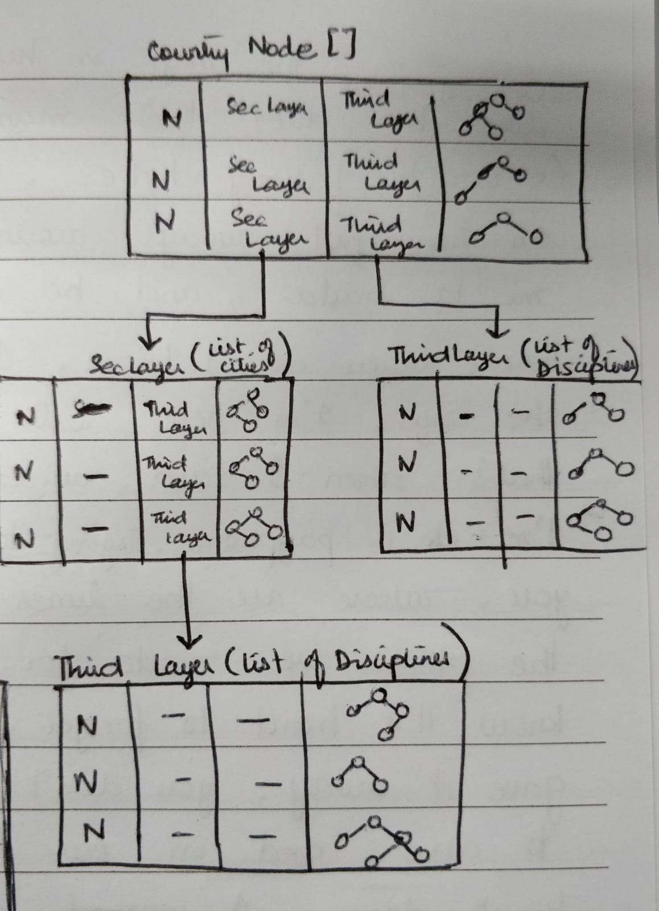
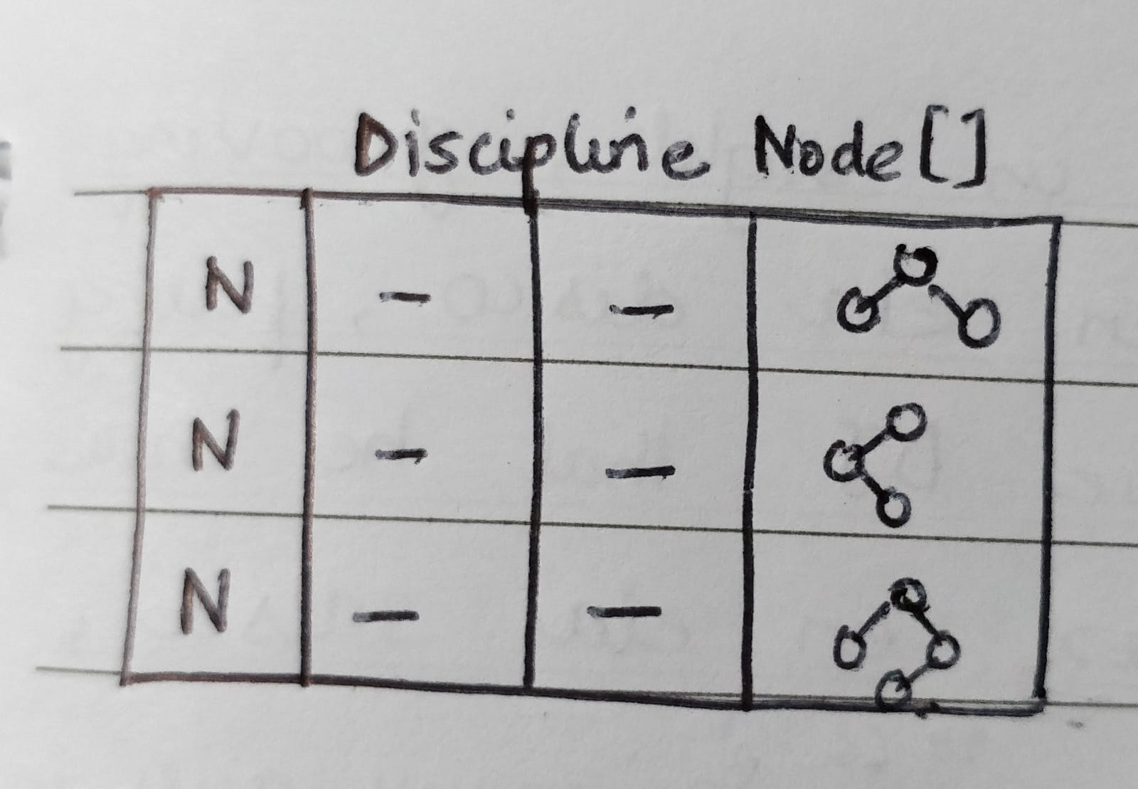
HashTable

Slide 28
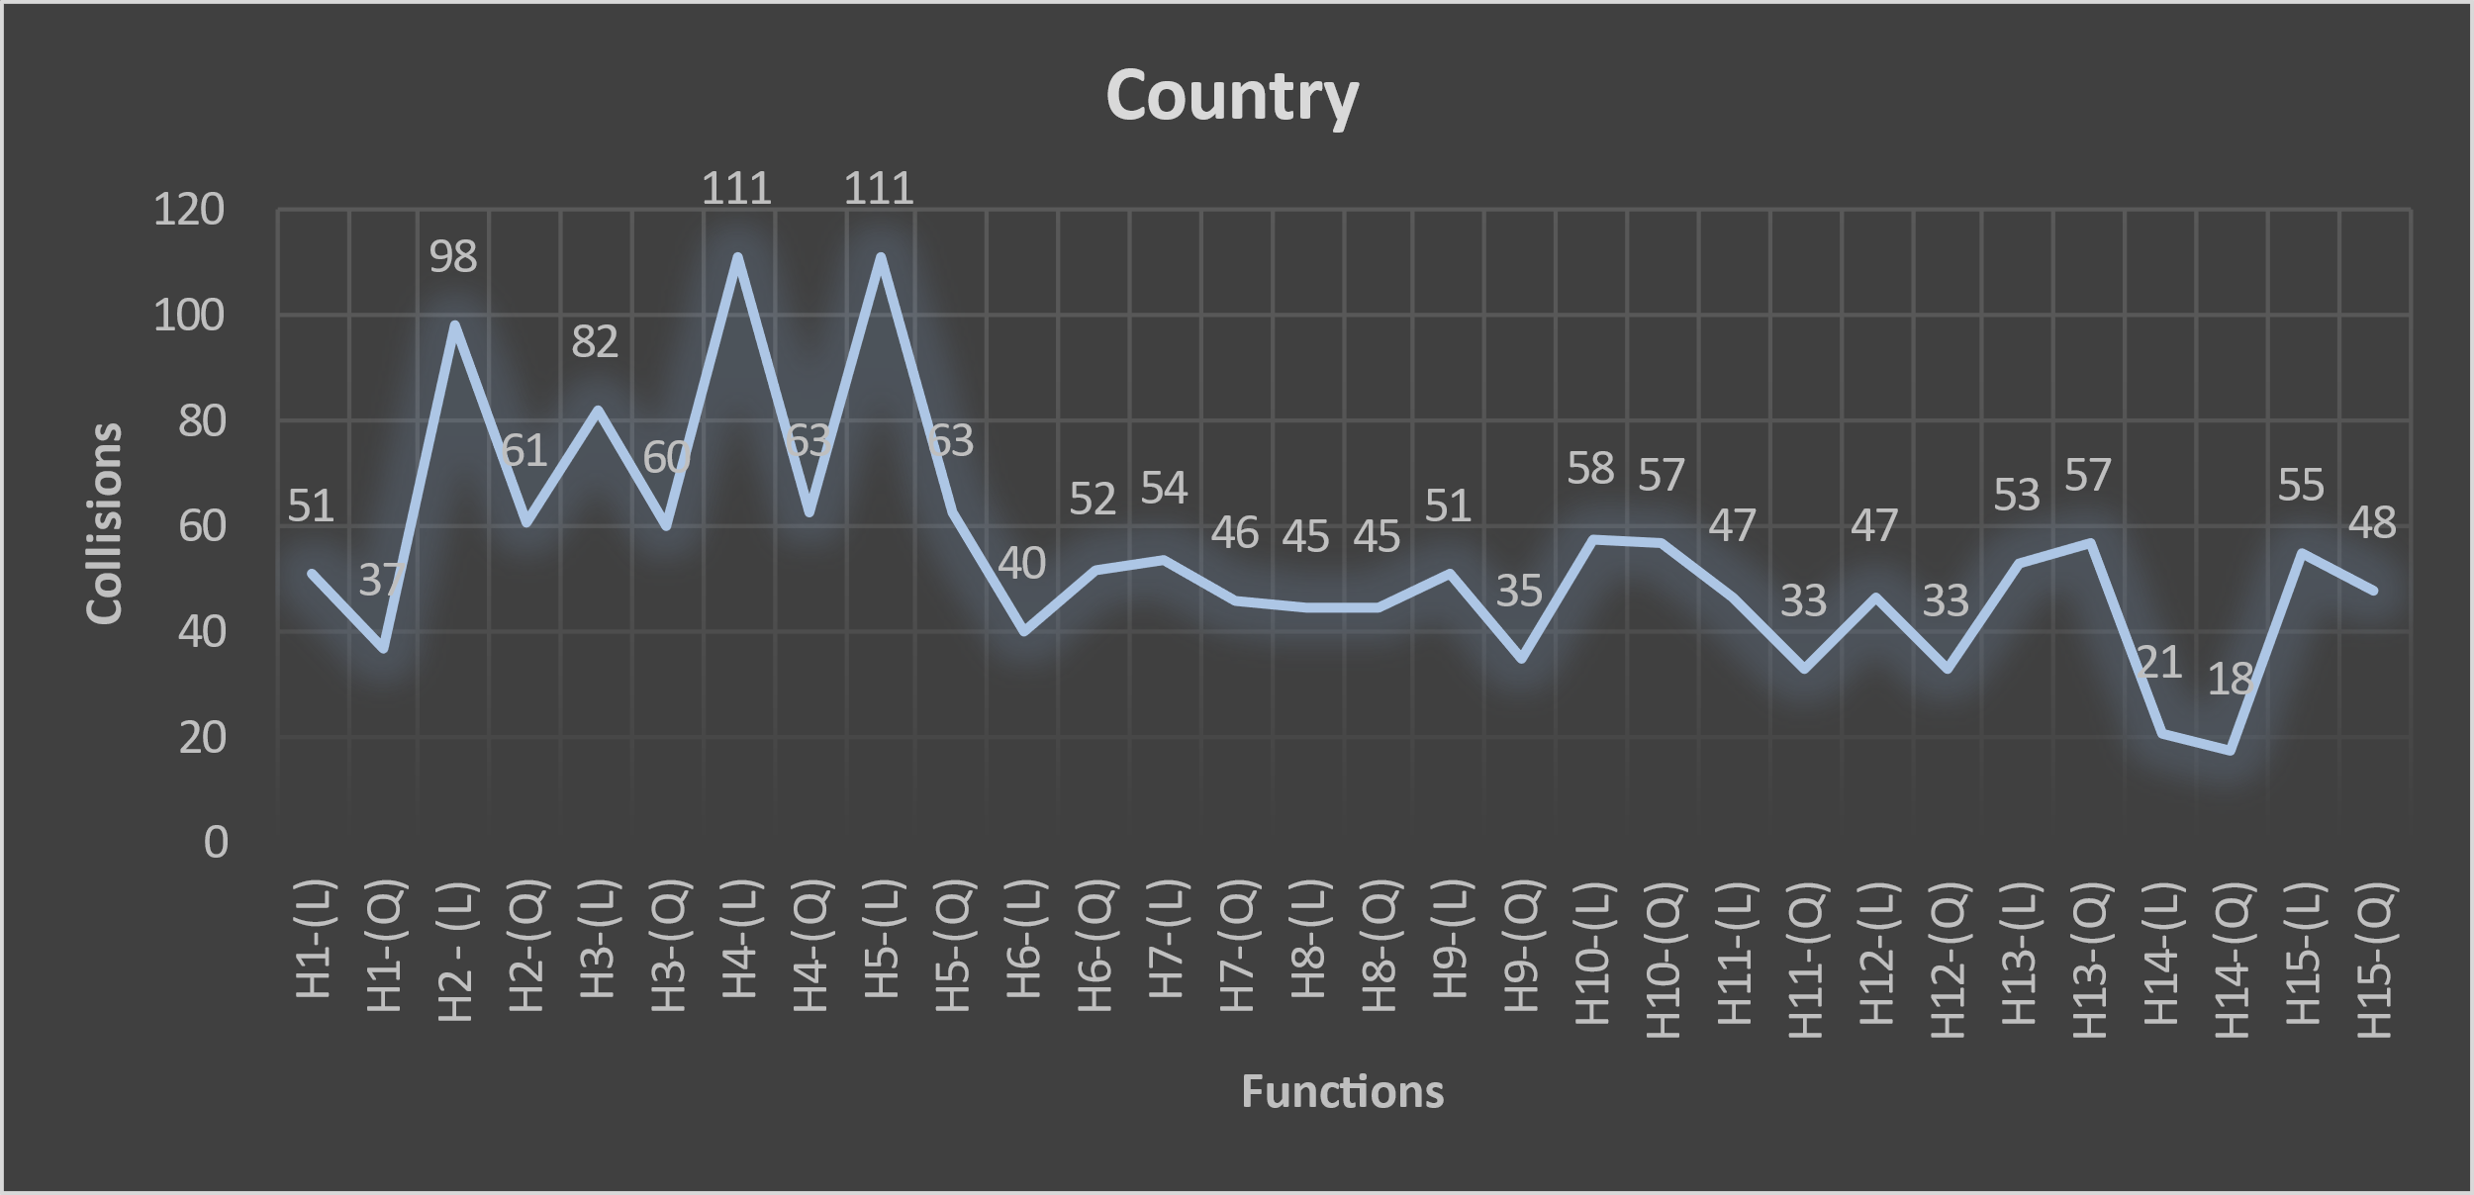
Collision Graphs

Slide 29
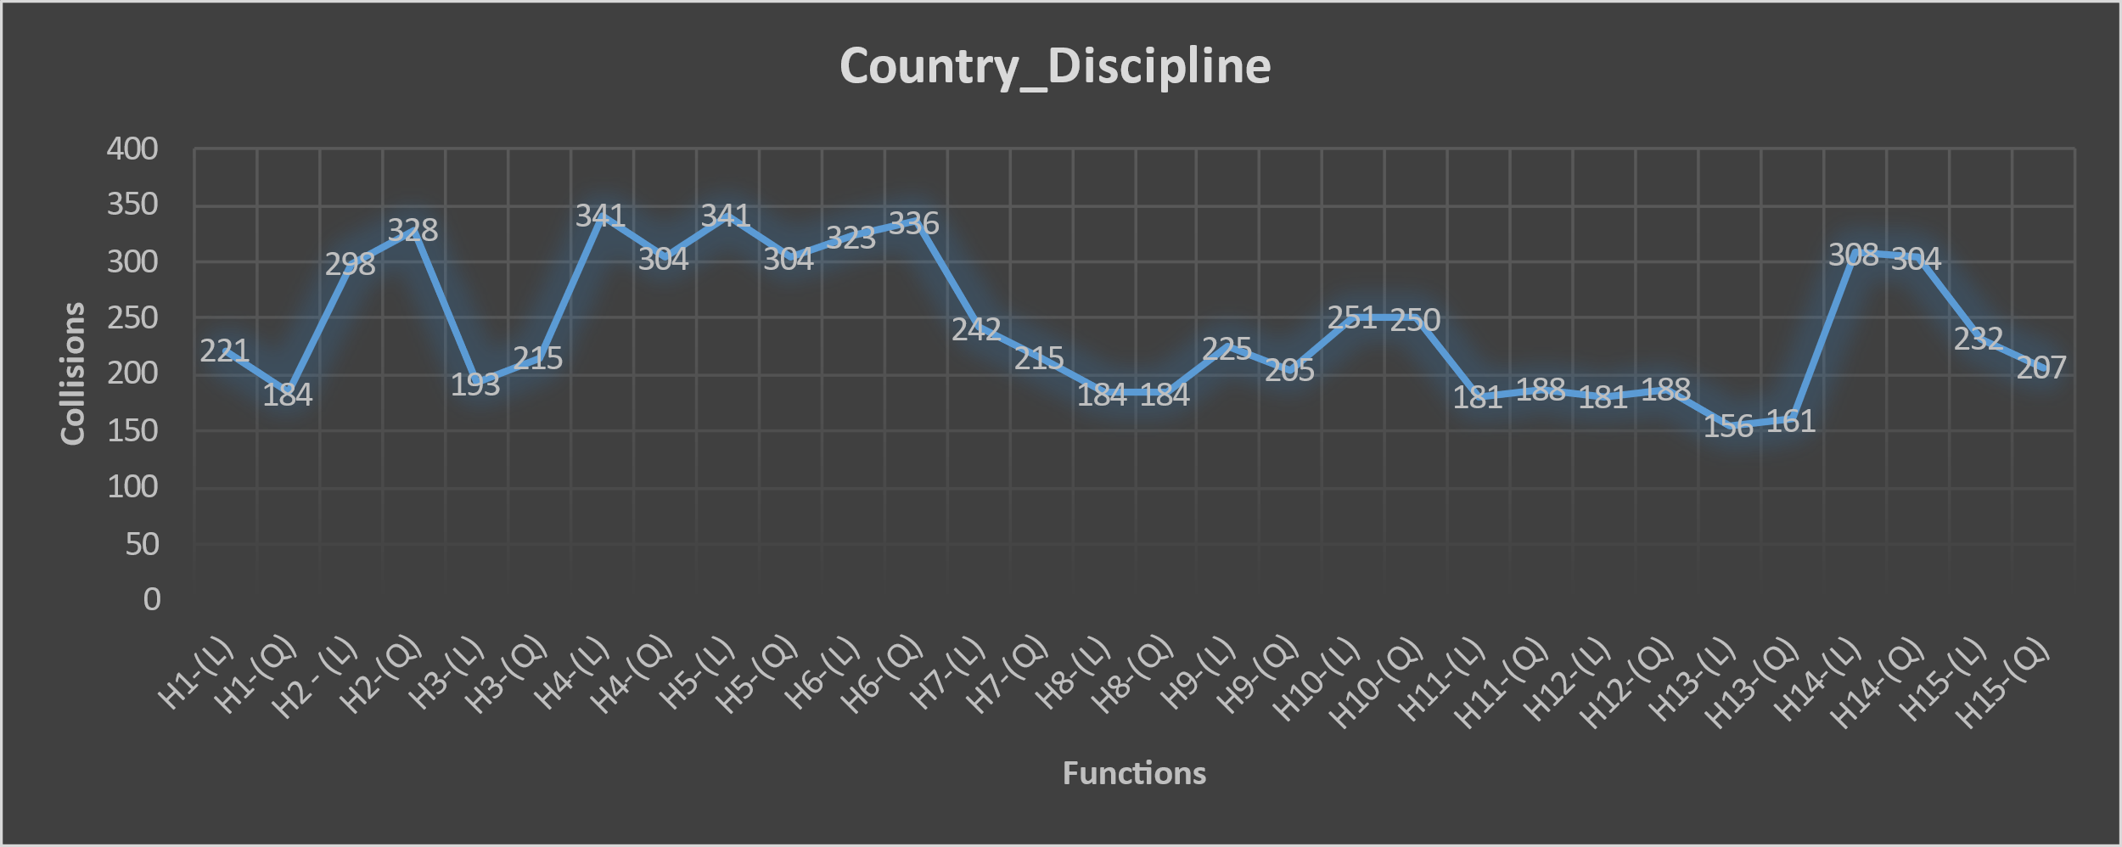
Collision Graphs

Slide 30
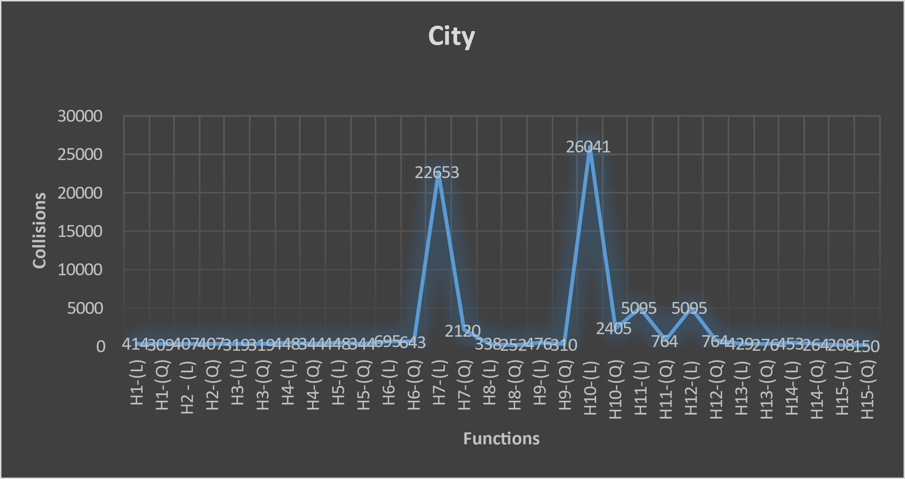
Collision Graphs

Slide 31
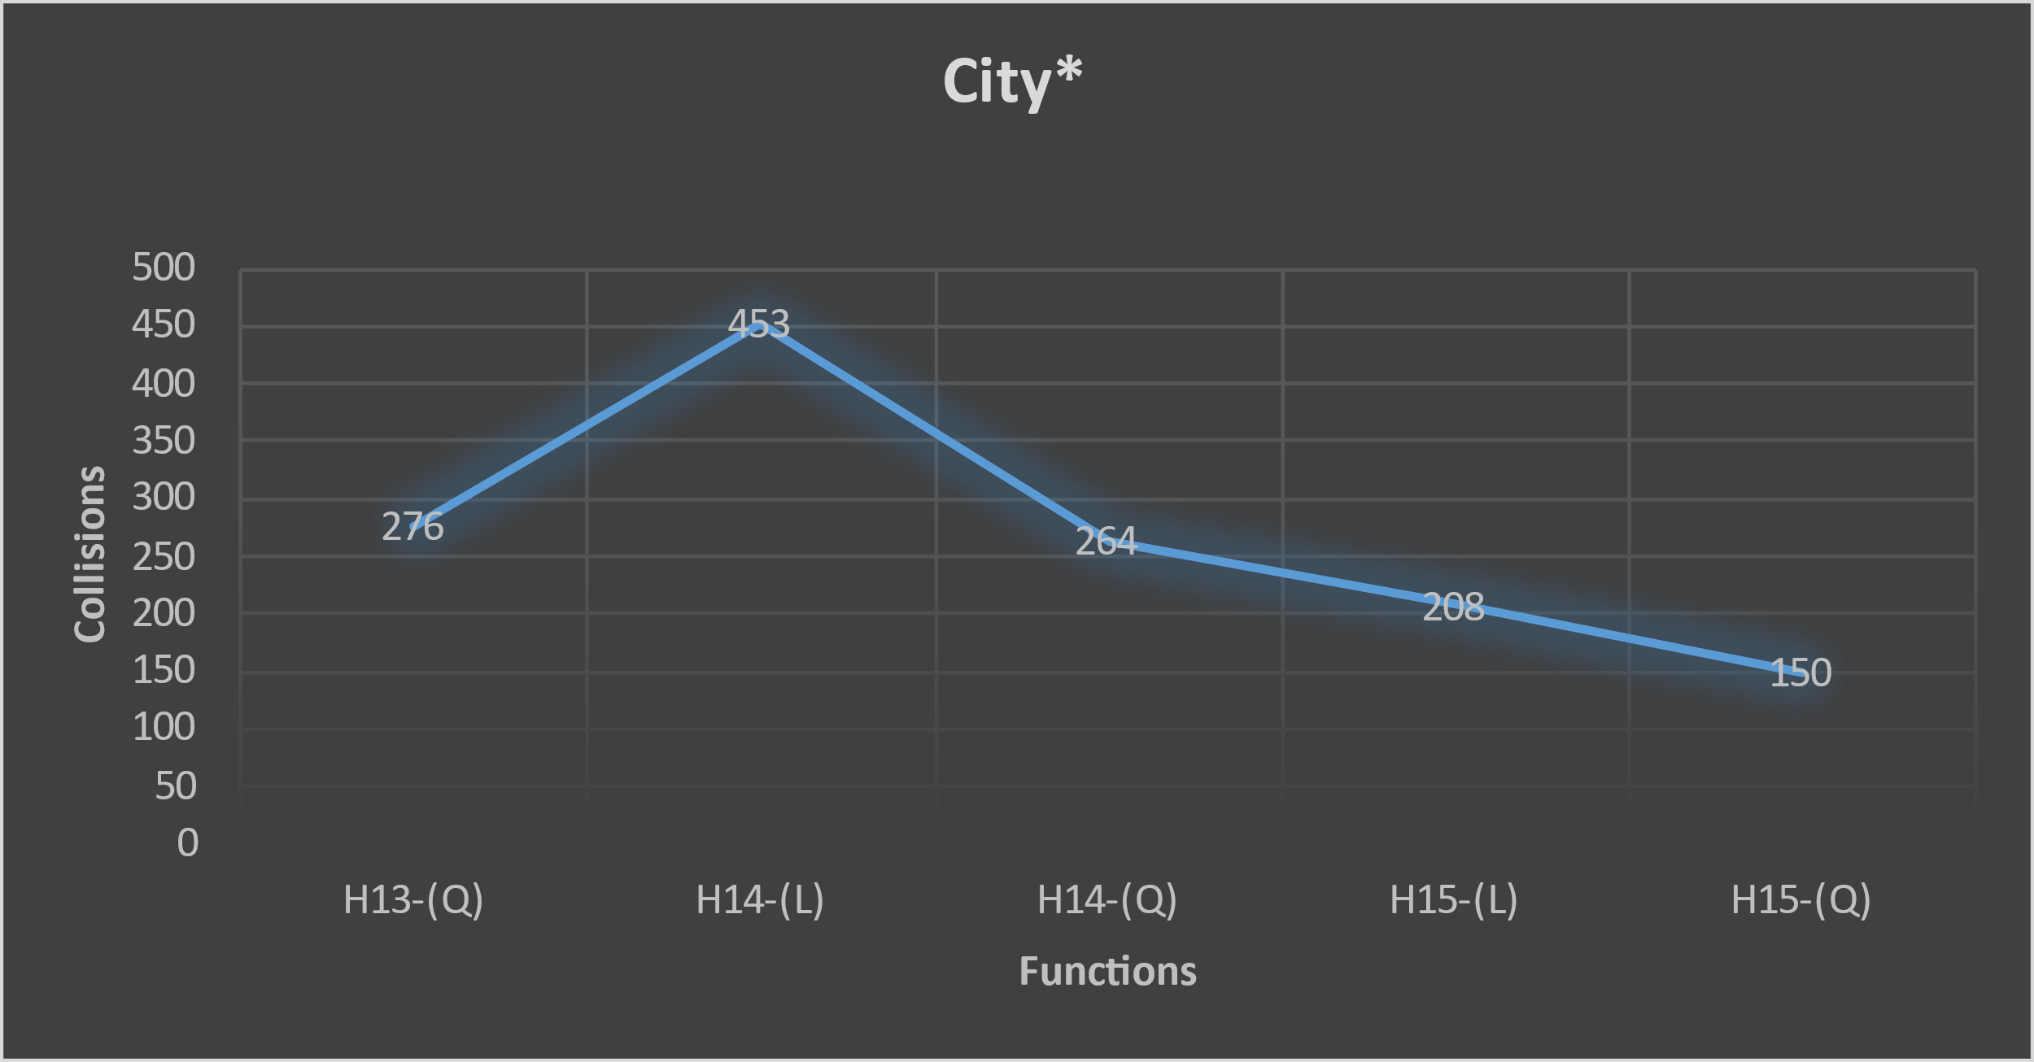
Collision Graphs

Slide 32
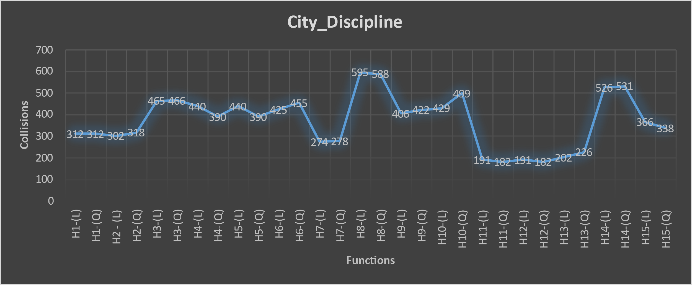
Collision Graphs

Slide 33
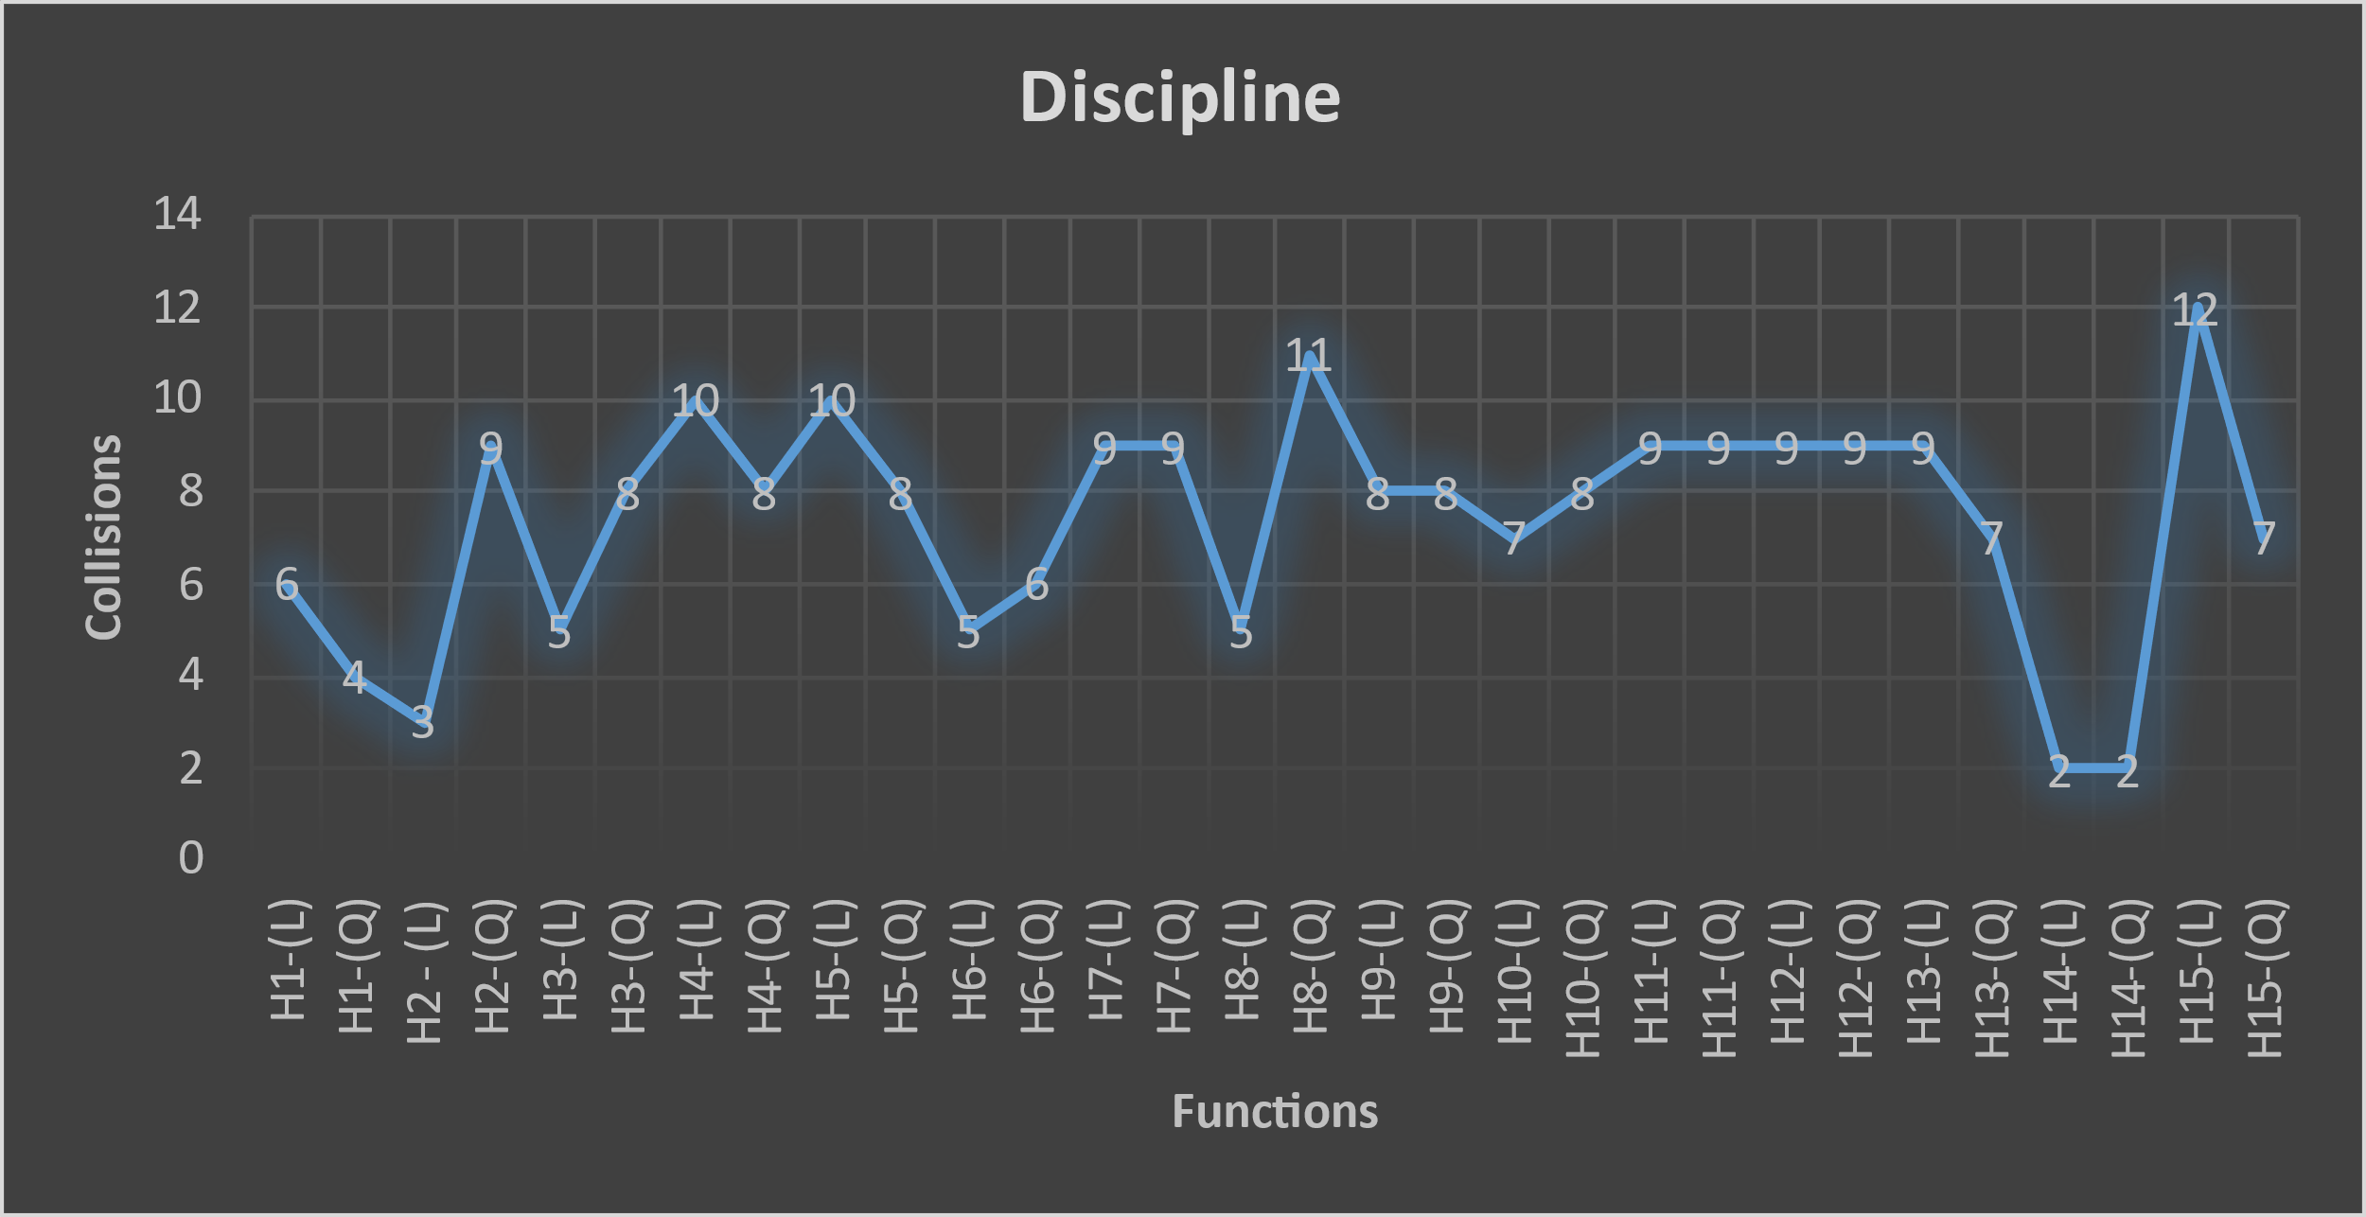
Collision Graphs

Slide 34
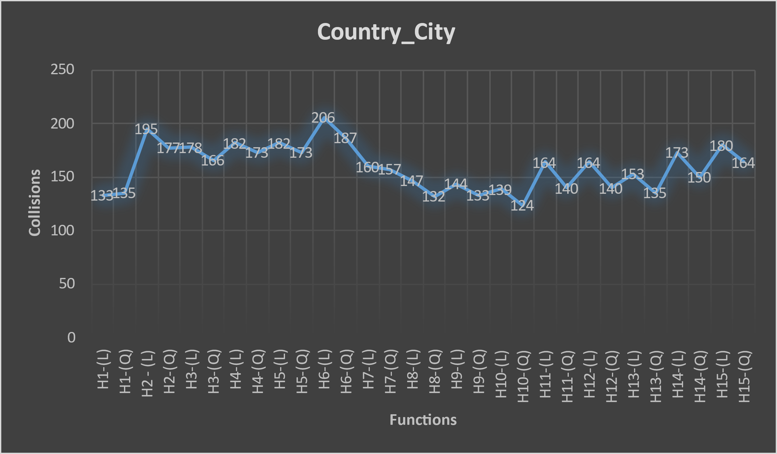
Collision Graphs

Slide 35
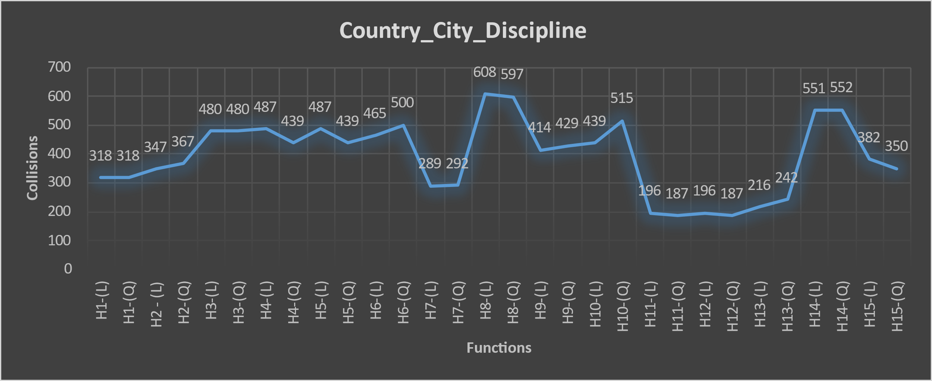
Collision Graphs

Slide 36
Hash Functions
H1 – (c1*i + c2*I +….) % arr.length
H2 - (c1*13 + c2*13 +….) % arr.length
H3 - (c1 * prime1 + c2*prime2 +….) % arr.length
H4 - (c1*13 + c2*13 +….) % arr.length (ignoring vowels)
H5 – ( (c1% arr.length) *13 + (c2% arr.length) *13 +….) % arr.length (ignoring vowels)
H6 - (sk1*13 + sk2*13 +….) % arr.length (sk:- self-key)
H7 - (sk1 + sk2 +….) % arr.length (sk:- self-key)
H8 – ((c1 * 53*i) + (c2 * 53*i) + …..)% arr.length
H9 - ((sk1 * 53*i) + (sk2 * 53*i) + …..)% arr.length(sk:- self-key)
H10 - (sk1 + sk2+….) % arr.length (ignoring vowels) (sk:- self-key)
H11- (sk1*i + sk2*i+….) % arr.length (ignoring vowels) (sk:- self-key)
H12- (((sk1*i)%arr.length) + ((sk2*i)%arr.length)+….) % arr.length (ignoring vowels) (sk:- self-key)
H13 - ((sk1 * 53^{i}) + (sk2 * 53^{i}) + …..)% arr.length(sk:- self-key)
H14 - ((sk1 * 66^{i}) + (sk2 * 66^{i}) + …..)% arr.length(sk:- self-key)
H15 – ((sk1 * 8^{i})+ (sk2 * 36^{i})+ (sk3*8^{i} )+ (sk4 * 36^{i}) + ……….) % arr.length ( sk:- self-key)

Slide 37
BIG O ANAYLSIS
Time Complexity
 | Constructor | toString | Insert | Find/Search
BST- Node | O(1) | O(1) | - | -
BST | O(1) | O(N) | O(logn)/O(N) | -
University_Node | O(1) (given that ready-made discipline array is taken as an argument) | O(1+No. of Disciplines) | - | -
University_LinkedList | O(1) | O(No. of nodes * No. of Disciplines ) | O(1)
Node | O(1) | - | - | -
Dynamic Array | O(1) | O(N) | O(1) | -
Hashtable | O( Country.length x Country[i].SecLayer.length x Country[i].SecLayer.ThirdLayer.lengthx O(BST.insert) ) | - | - | O(Country.length x Country[i].SecLayer.length x Country[i].SecLayer.ThirdLayer.length x O(BST.LNR))

Slide 38
BIG O ANAYLSIS
University_LinkedList
UniInCountry UniInCity UniInDiscipline UniInCountryCity UniInCountryDiscpline UniInCityDiscipline UniInCountryCityDiscipline | Get_Country GetCity Get_Discipline | Get_CountryList GetCityList Get_DisciplineList Get_CityInCountryList Get_DisciplineInCountryList Get_DisciplineInCityList Get_DisciplineInCityAndCountry_List
O(N) | O(N) | O(N)
Dynamic Array
Trim() | ReturnArray() | Contains() | Length()
O(N) | O(N) | O(N) | O(1)

Slide 39
BIG O ANAYLSIS
HashTable
Build Hash | Get_Key_Country Get_Key_City Get_Key_Discipline Get_Key_CountryCity Get_Key_CountryDiscipline Get_Key_CityDiscipline | InsertInListLinear InsertInListAlternate | InsertUni | Update
O( Country.length x Country[i].SecLayer.length x Country[i].SecLayer.ThirdLayer.lengthx O(BST.insert) ) | O(Str.length) | O(N) | O( Country.length x Country[i].SecLayer.length x Country[i].SecLayer.ThirdLayer.lengthx O(BST.insert) ) | O(UniList.length)

Slide 40
BIG O ANAYLSIS
Space Complexity
 | Constructor | toString\LNR | Insert | Find/Search
BST- Node | O(1) | O(1) | - | -
BST | O(1) | O(N)( ie Total Nodes In BST) | O(1) | -
University_Node | O(1) | O(1) | - | -
University_LinkedList | O(1) | O(1) | O(N) | -
Node | O(1) | - | - | -
Dynamic Array | O(1) | O(1) | O(1) | -
Hashtable | O( Country.length x Country[i].SecLayer.length x Country[i].SecLayer.ThirdLayer.lengthx O(BST.insert) ) | - | - | O(1)

Slide 41
BIG O ANAYLSIS
University_LinkedList
UniInCountry UniInCity UniInDiscipline UniInCountryCity UniInCountryDiscpline UniInCityDiscipline UniInCountryCityDiscipline | Get_Country GetCity Get_Discipline | Get_CountryList GetCityList Get_DisciplineList Get_CityInCountryList Get_DisciplineInCountryList Get_DisciplineInCityList Get_DisciplineInCityAndCountry_List
O(1) | O(N) | O(N)
Dynamic Array
Trim() | ReturnArray() | Contains() | Length()
O(1) | O(1) | O(1) | O(1)

Slide 42
BIG O ANAYLSIS
HashTable
Build Hash | Get_Key_Country Get_Key_City Get_Key_Discipline Get_Key_CountryCity Get_Key_CountryDiscipline Get_Key_CityDiscipline | InsertInListLinear InsertInListAlternate | InsertUni | Update
O( Country.length x Country[i].SecLayer.length x Country[i].SecLayer.ThirdLayer.lengthx O(BST.insert) ) | O(1) | O(1) | O( Country.length x Country[i].SecLayer.length x Country[i].SecLayer.ThirdLayer.lengthx O(BST.insert) ) | O(1)

Slide 43
https://www.geeksforgeeks.org/
https://www.cs.cmu.edu/~pattis/15-1XX/common/handouts/ascii.html
https://www.qs.com/?s=excel
List of References

